Slide 1


Water Quality Modeling
EWRI Congress 2025
EPA SWMM5 Technical Workshop
Anchorage AK, May 18, 2025

Slide 2

Outline
Urban runoff quality
SWMM5 water quality processes
Surface buildup and washoff
Routing and treatment
Reference Manual
Volume III – Water Quality
(at www.epa.gov)

Slide 3

Urban Runoff Quality
EWRI Congress 2025, EPA SWMM5 Workshop -- Water Quality Modeling

Slide 4
Common Pollutants in Stormwater
Sediment: more on this later…
Nutrients: various forms of Nitrogen and Phosphorus, more later…
Metals: cadmium, copper, lead, mercury, zinc
Pathogens: fecal coliform/streptococci & other bacteria, viruses, microorganisms
Dissolved oxygen and biological/chemical/sediment oxygen demand
Chlorides: dissolved salts from deicing activities and water softeners
Toxicants: pesticides, herbicides, plasticizers, solvents, household cleaners
Not simulated in SWMM5: oil/grease and other floatables, temperature, pH, turbidity, color, alkalinity, specific conductance, etc.

Slide 5
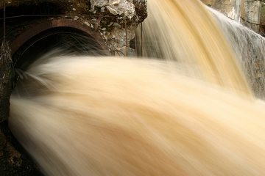
Substances in Flowing Water
Buoyant materials on surface
Dispersed materials in water
Solids held in suspension by turbulence
Colloidal/dissolved material in chemical solution
Bed material on the bottom
Sources of sediments/solids
Urban “dirt”
Streambank erosion
Construction/earthmoving activities
Channel/land use modifications

Slide 6
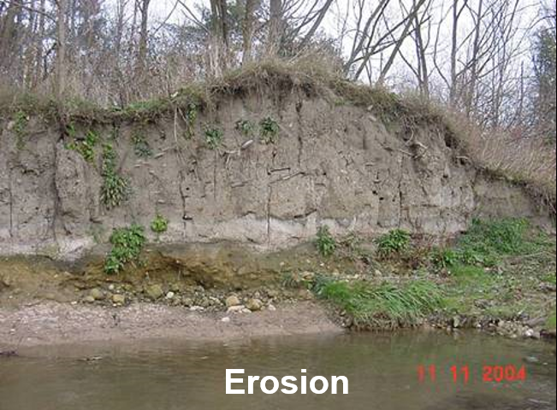
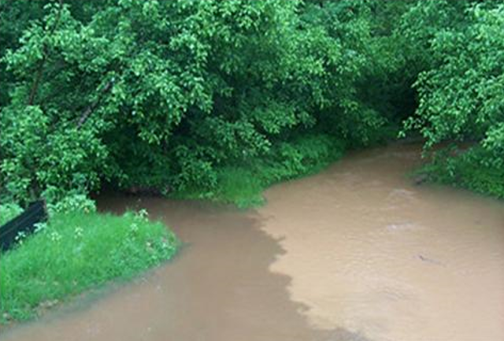
Sediment
Pollutant
Affects feeding, respiration, spawning of fish
Restricts light (increases turbidity)
Siltation/clogging of hydraulic structures
Preferential settling of largest particles
Medium for transporting pollutants
Fine-textured material (clay, organics)
Likely to be transported in suspension
Able to adsorb/absorb constituents
Preferential transport of finest particles
Treatment processes require low turbidity to operate efficiently

Slide 7
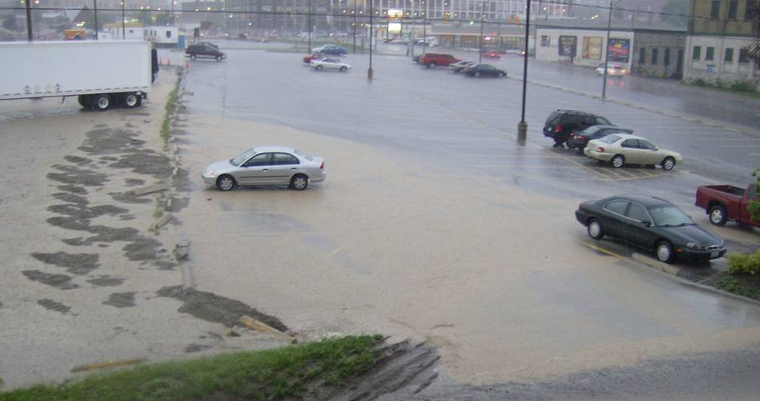
TSS – One Size Does Not Describe All
Total Suspended Solids comprise a bunch of particle sizes (e.g., d50 or PSD)
According to NURP (U.S. EPA, 1983), particle size distribution of dirty water is:
Size and hydraulic residence times are critical
Preferential settling of large particles (bedload)
Preferential transport of small particles (washload)
very fine sand > 63μm > coarse silt
moving on (<63μm)
settling in
(>63μm)

Slide 9
Typical Urban Runoff Event Mean Concentrations
Constituent | Units | Mean EMC
Total Suspended Solids | mg/L | 78.4
Biological Oxygen Demand* |  | 14.1
Chemical Oxygen Demand* |  | 52.8
Total Phosphorous |  | 0.32
Soluble Phosphorous |  | 0.13
Total Kjeldahl Nitrogen |  | 1.73
Nitrite and Nitrate |  | 0.66
Copper | μg/L | 13.4
Lead |  | 67.5
Zinc |  | 162
Fecal Coliform* | colonies/100 mL | 15,038
Fecal Streptococci* |  | 35,351
* Temperature is not accounted for in SWMM Water Quality modeling and therefore Biological and Chemical Oxygen Demand may not be modeled accurately
Source: Center for Watershed Protection (CWP), Impacts of Impervious Cover on Aquatic Systems, Watershed Protection Research Monograph No.1, Center for Watershed Protection, Ellicott City, MD, March 2003.

Slide 10
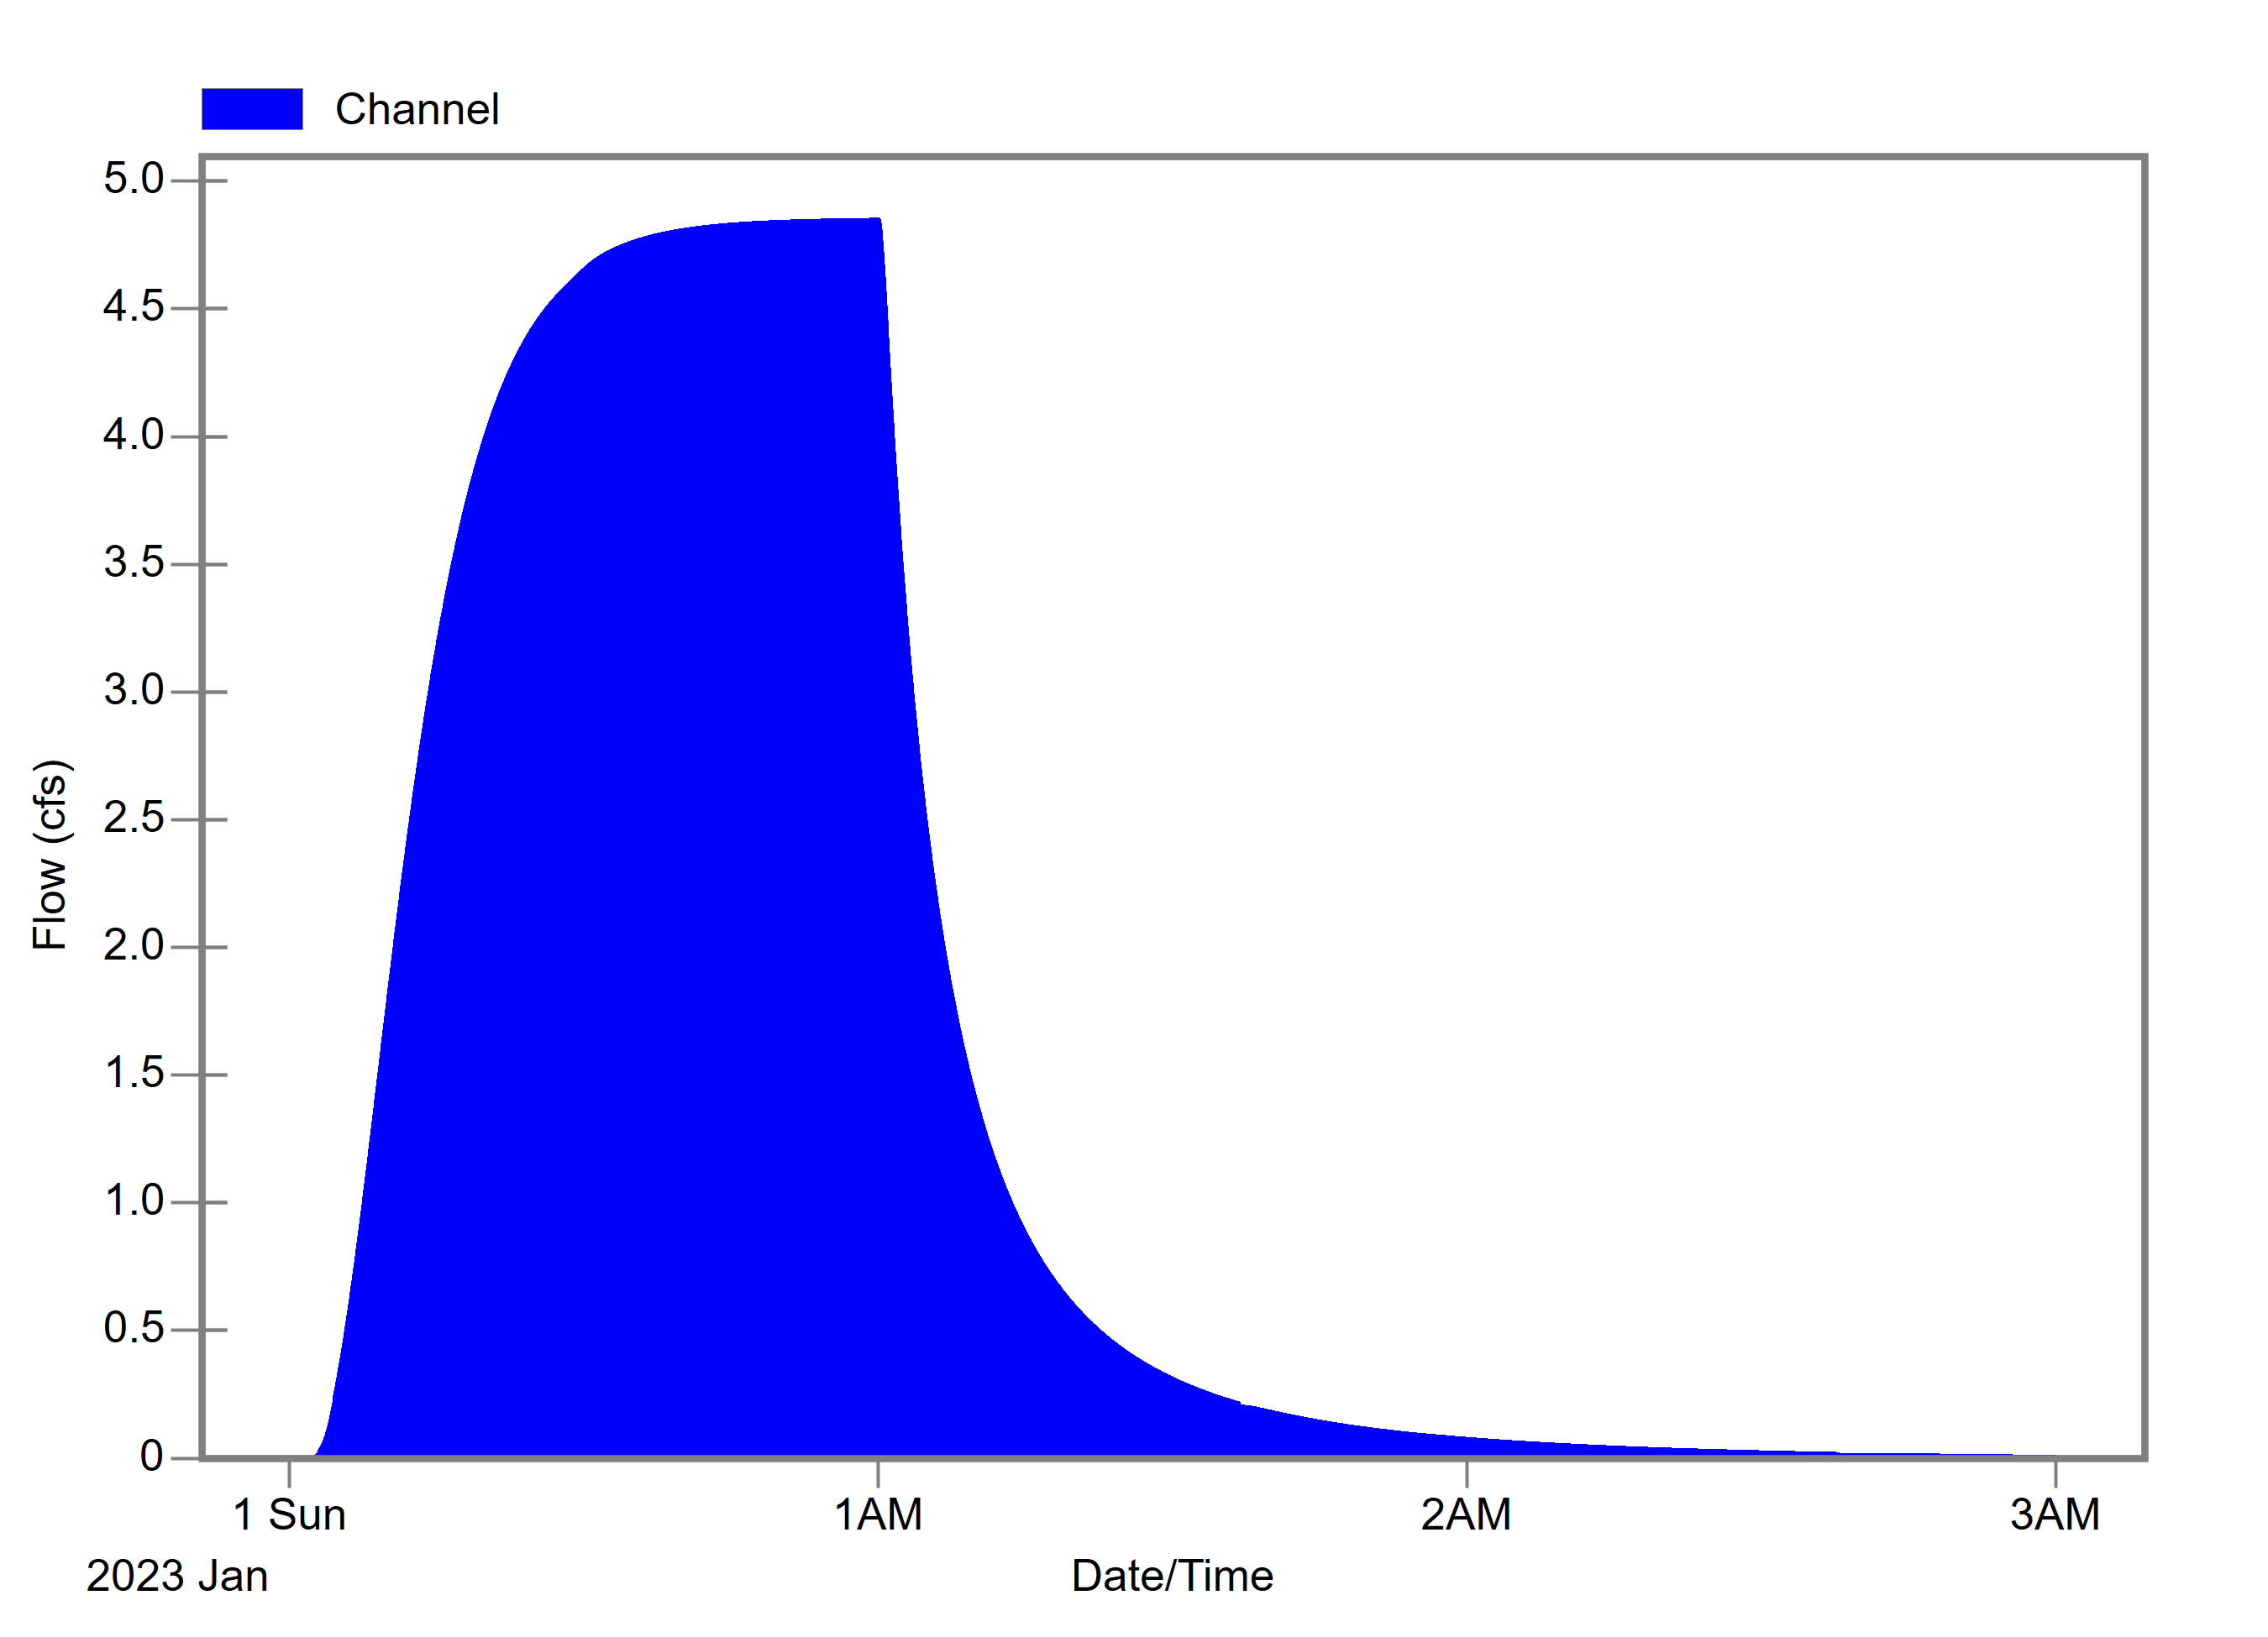
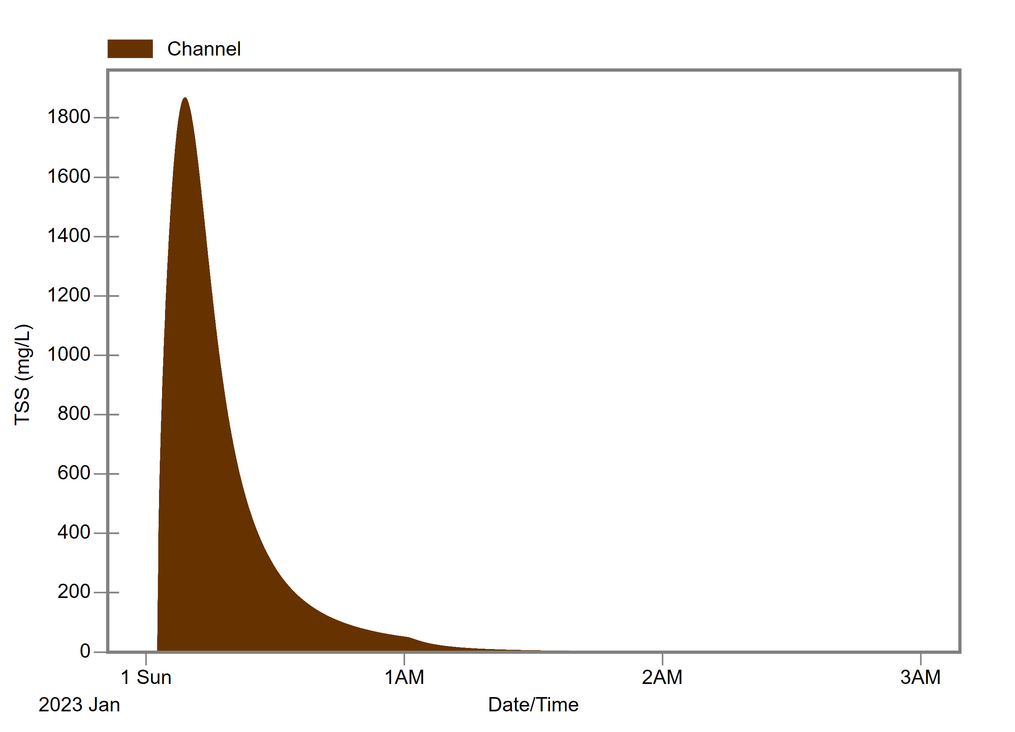
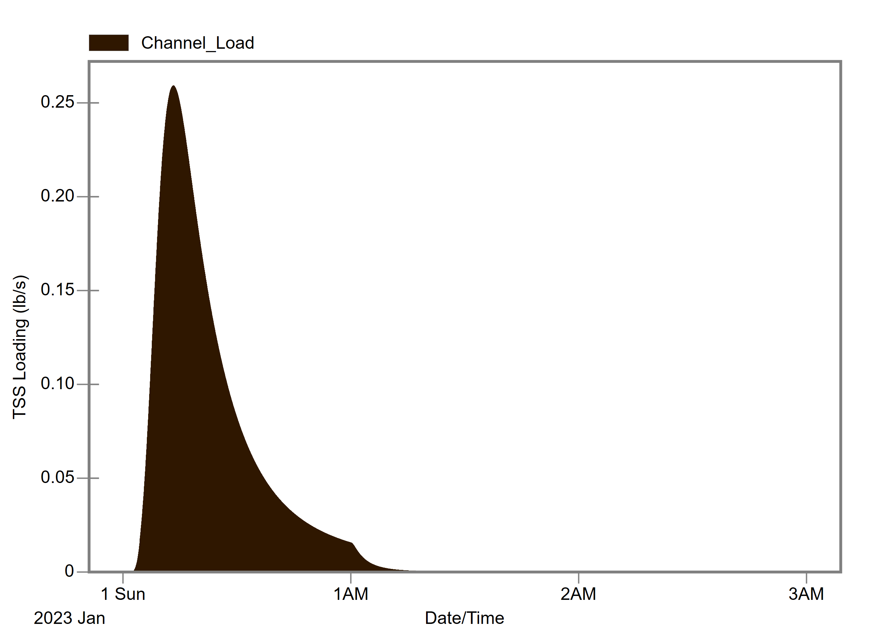
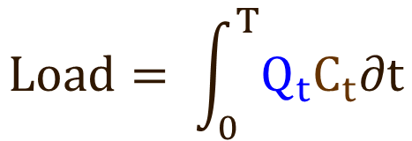
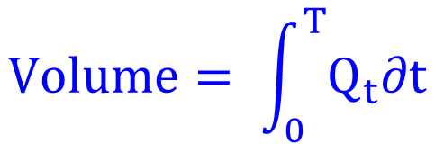
Quantifying Quantity and Quality
Hyetograph: rainfall timeseries
Hydrograph: water quantity flow rate, Q_{t}
Pollutograph: pollutant concentration, C_{t}
Loadograph: pollutant mass loading rate, L_{t} = Q_{t}×C_{t}
Flow Hydrograph Q_{t} (ft³/s)
TSS Pollutograph C_{t} (mg/L)
TSS Loadograph L_{t} (lb/s)
$$Volume= \int_{0}^{T}{Q_{t}∂t}$$
$$Load= \int_{0}^{T}{Q_{t}C_{t}∂t}$$

Slide 11
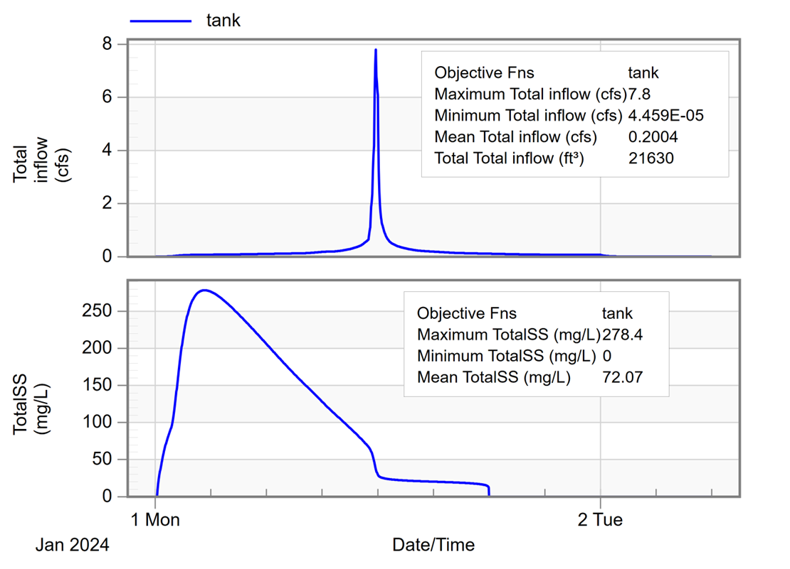
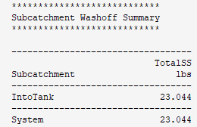
Event Mean Concentration
EMC: Total pollutant load divided by flow volume over the event duration
Concentrations can vary very much during an event, EMC is the overall average
Handy unit conversions:
28.317 L per ft3
453592.4 mg per lb
For continuous simulation, parse the timeseries into runoff-producing, pollutant-generating events
Example: rainfall minimum interevent time = 12hr, pollutant threshold = 0 mg/L)
Top 10 Total Suspended Solids “events”…
EMC = 23 lb ÷ 21,630 ft³ = 71 mg/L

Slide 12
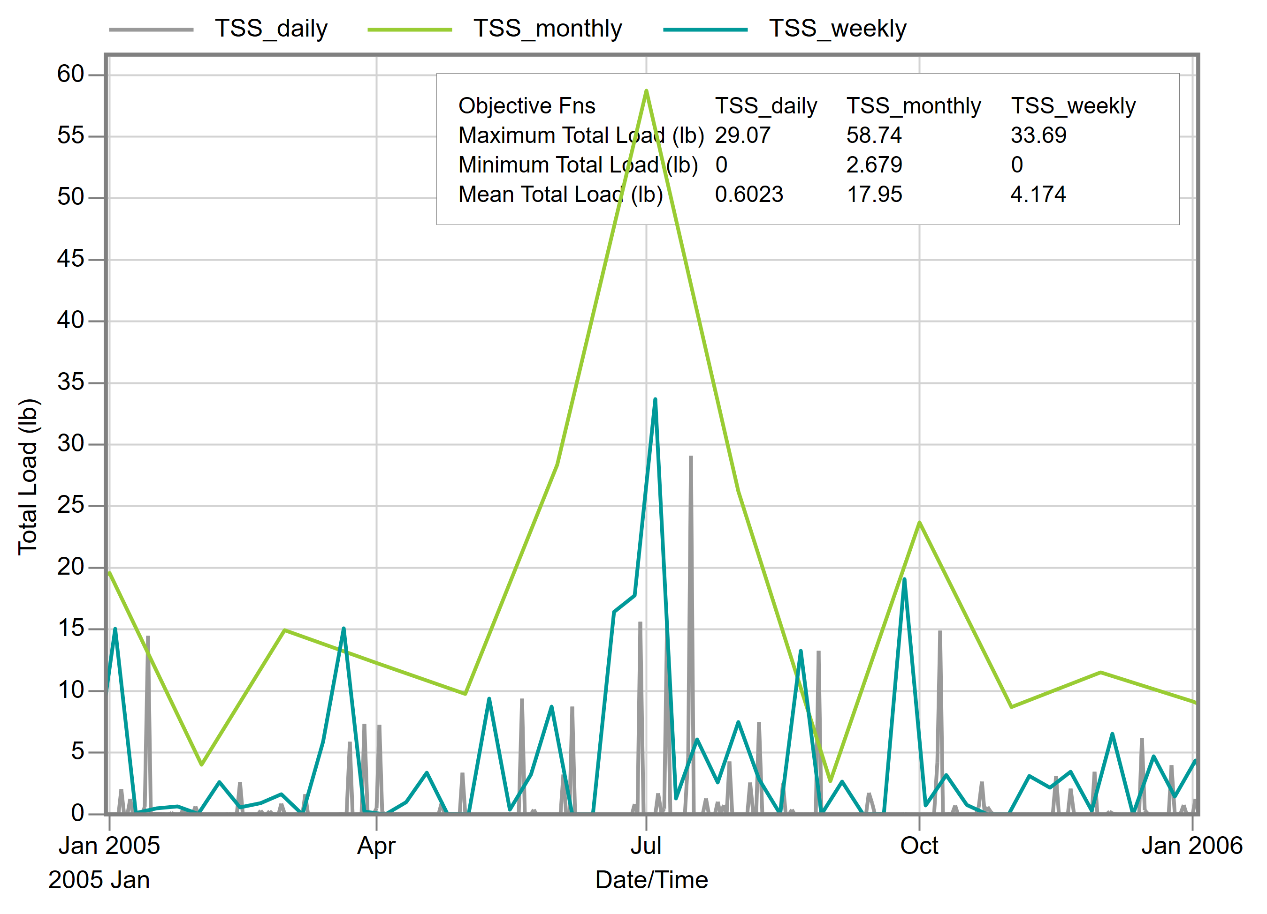
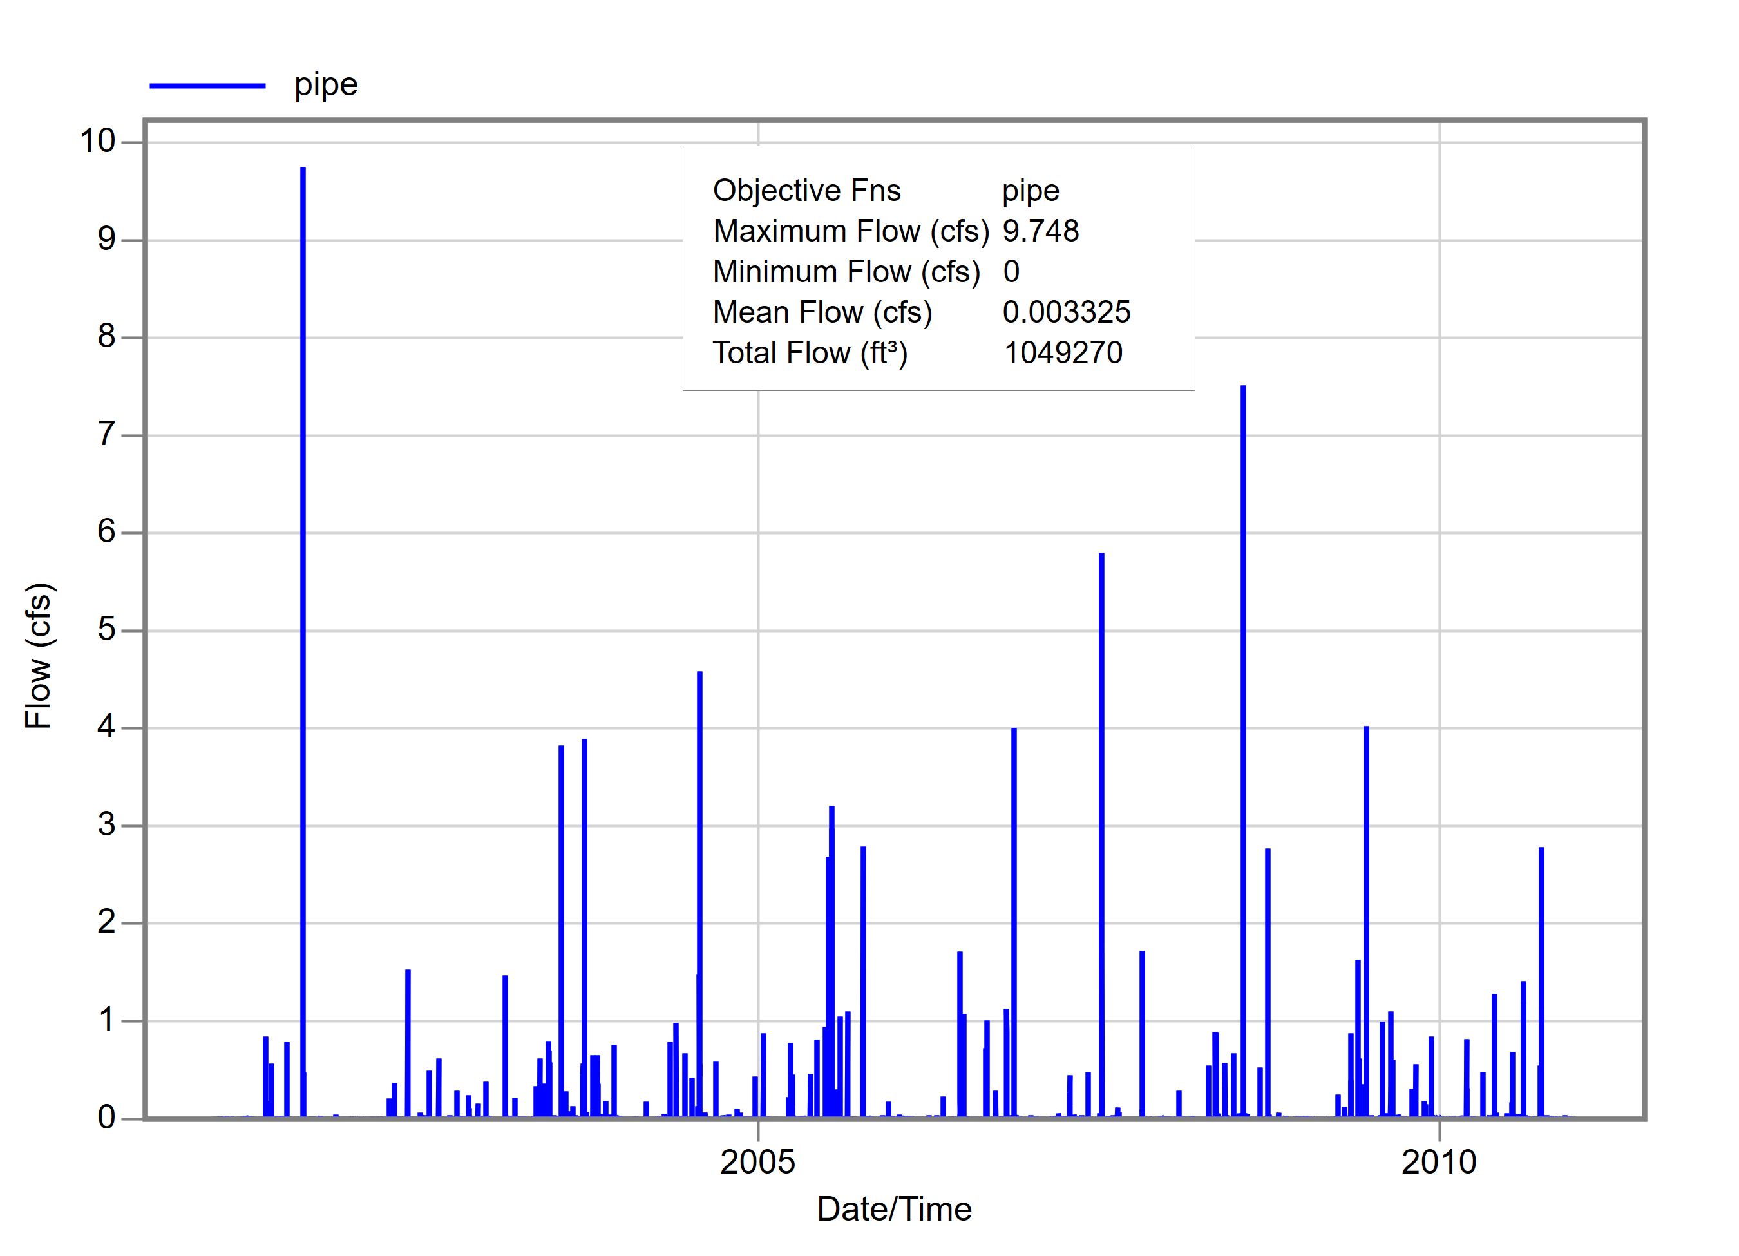
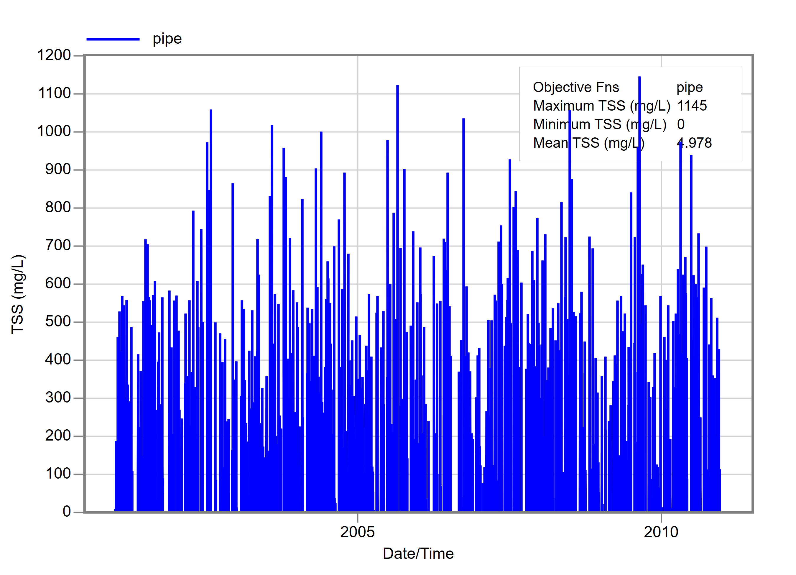
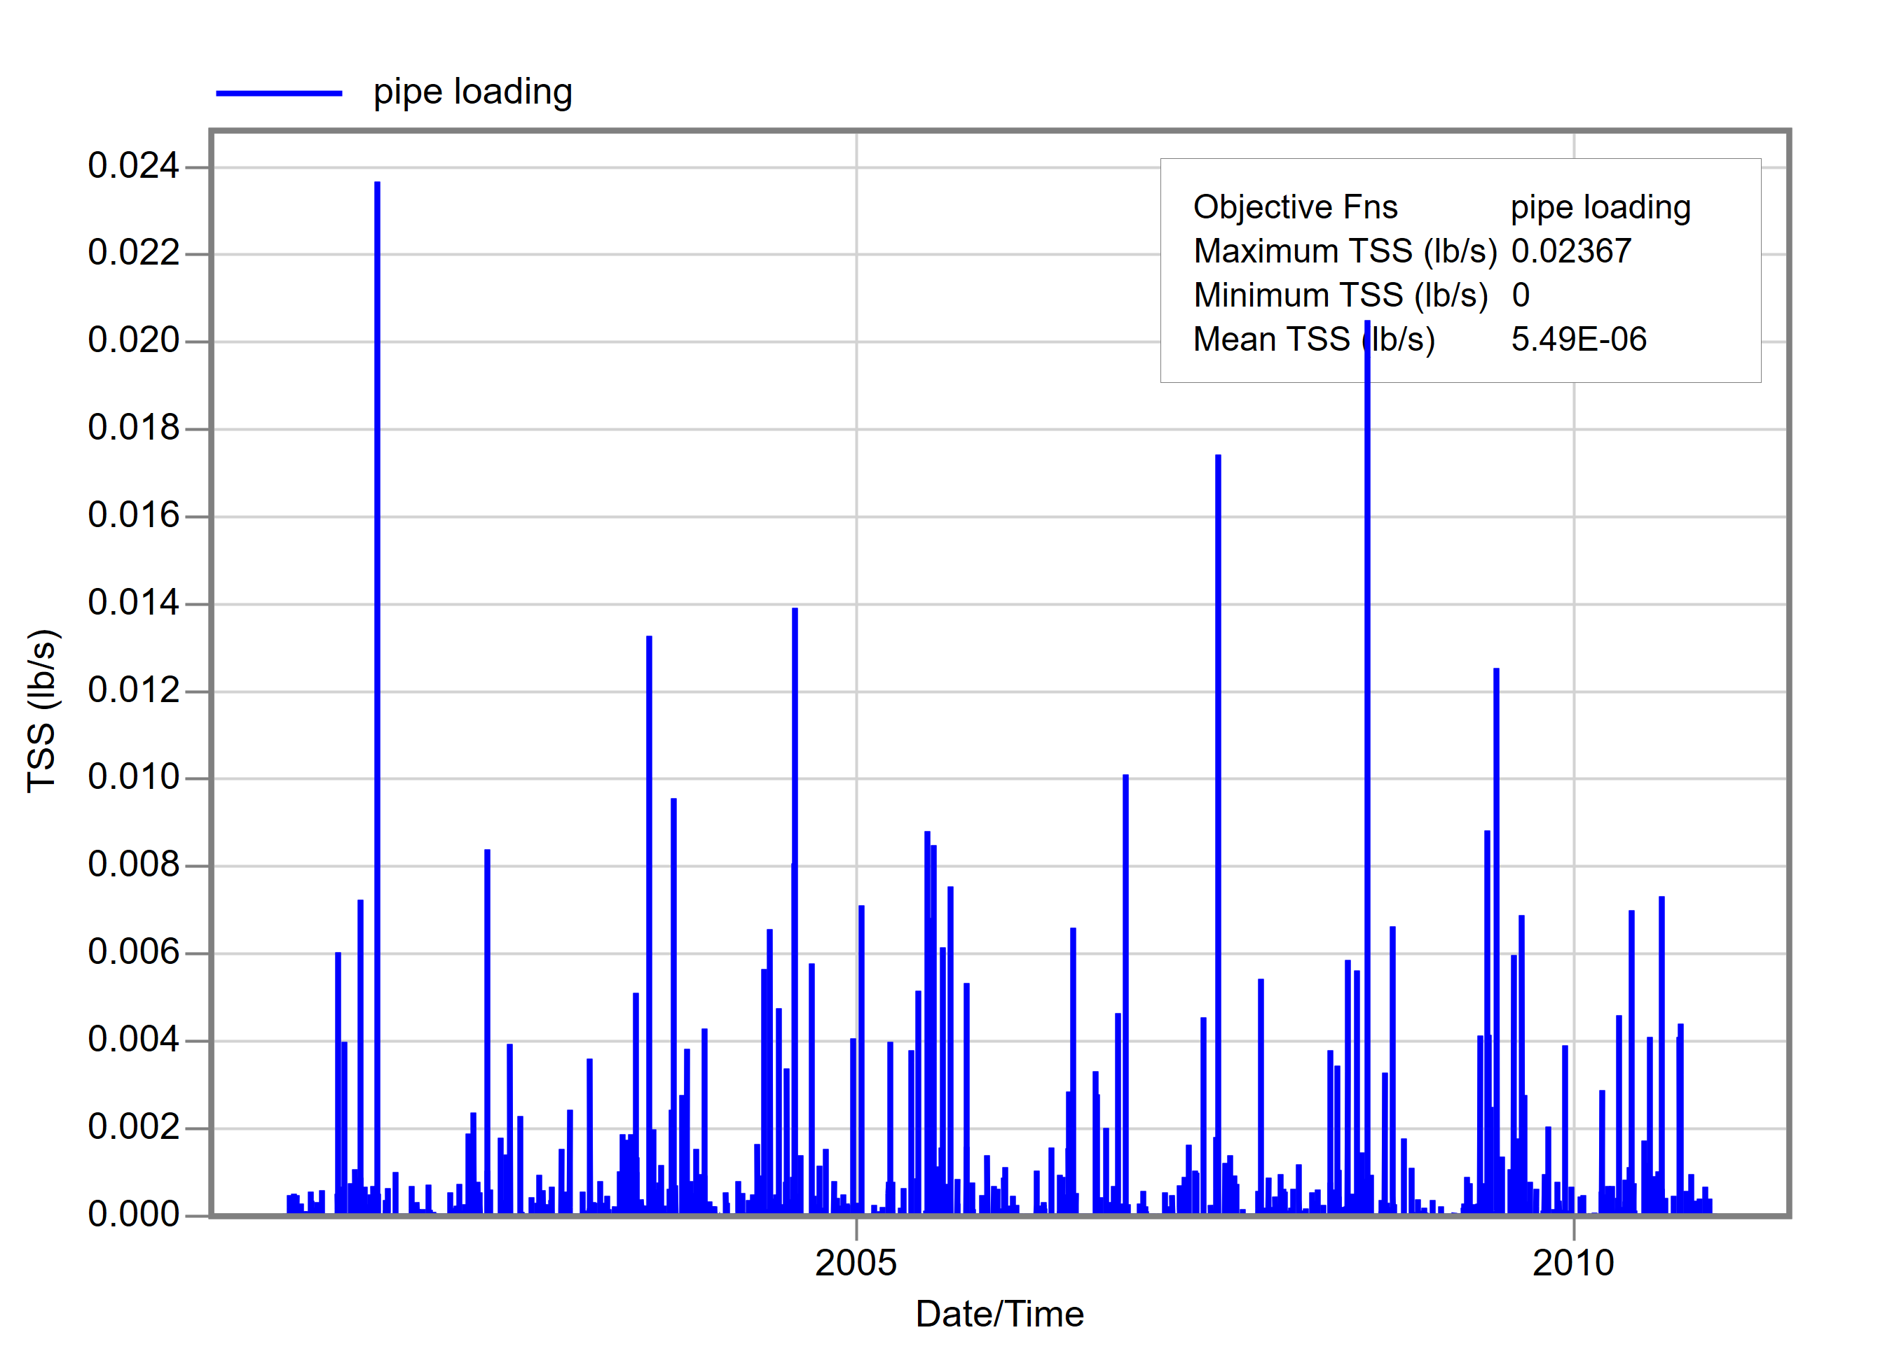
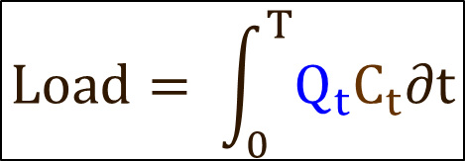
Pollutant Load
Load: Pollutant mass passing a given point over a given period of time
Load = Concentration × Flowrate
And since concentrations and flows are highly variable in stormwater systems, so too is load
Always know the concentration averaging and load accumulation periods
$$Load= \int_{0}^{T}{Q_{t}C_{t}∂t}$$

Slide 13
SWMM5 Water Quality Processes
EWRI Congress 2025, EPA SWMM5 Workshop -- Water Quality Modeling

Slide 14
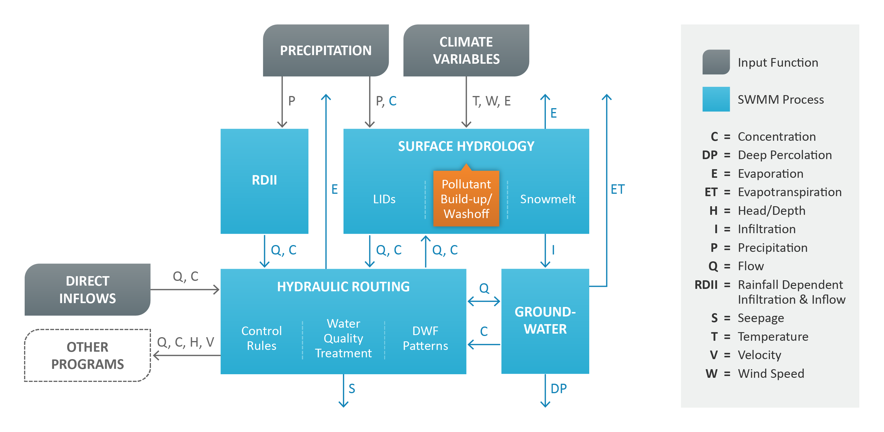
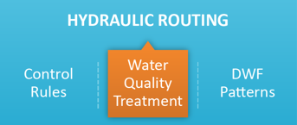
SWMM Process Schematic

Slide 15
Water Quality Processes
Pollutant loads/concentrations come from…
“Buildup” during dry weather and “washoff” during rainfall
Other contributions such as wet deposition (i.e., with the rainfall), groundwater, sanitary sewer flows, external inflows, etc.
Pollutants move through the hydraulic network…
Dispersed/diluted within storage facilities (in SWMM5 nodes)
Routed through the conveyance system (in SWMM5 links)
Pollutant loads/concentrations can be reduced due to…
Street cleaning practices before washoff into the hydraulic network
Treatment or natural processes within the hydraulic network

Slide 16
SWMM5.2 Input File Sections
May contain water quality input parameters
Hydrology
[RAINGAGES] rain gage information
[EVAPORATION] evaporation data
[TEMPERATURE] air temperature and snow melt data
[ADJUSTMENTS] monthly adjustments applied to climate variables
[SUBCATCHMENTS] basic subcatchment information
[SUBAREAS] subcatchment impervious/pervious sub-area data
[INFILTRATION] subcatchment infiltration parameters
[LID_CONTROLS] low impact development control information
[LID_USAGE] assignment of LID controls to subcatchments
[AQUIFERS] groundwater aquifer parameters
[GROUNDWATER] subcatchment groundwater parameters
[GWF] groundwater flow expressions
[SNOWPACKS] subcatchment snow pack parameters
Hydraulics
[JUNCTIONS] junction node information
[OUTFALLS] outfall node information
[DIVIDERS] flow divider node information
[STORAGE] storage node information
[CONDUITS] conduit link information
[PUMPS] pump link information
[ORIFICES] orifice link information
[WEIRS] weir link information
[OUTLETS] outlet link information
[XSECTIONS] conduit, orifice, and weir cross-section geometry
[TRANSECTS] transect geometry for conduits with irregular cross-sections
[STREETS] cross-section geometry for street conduits
[INLETS] design data for storm drain inlets
[INLET_USAGE]assignment of inlets to street and channel conduits
[LOSSES] conduit entrance/exit losses and flap valves
[CONTROLS] rules that control pump and regulator operation
[CURVES] x-y tabular data referenced in other sections
Job Control
[TITLE] project title
[OPTIONS] analysis options
[REPORT] output reporting instructions
[FILES] interface file options
H&H
[INFLOWS] external hydrograph/pollutograph inflow at nodes
[TIMESERIES] timeseries data referenced in other sections
[PATTERNS] periodic multipliers referenced in other sections
Water Quality
[POLLUTANTS] pollutant information
[LANDUSES] land use categories
[COVERAGES] assignment of land uses to subcatchments
[LOADINGS] initial pollutant loads on subcatchments
[BUILDUP] buildup functions for pollutants and land uses
[WASHOFF] washoff functions for pollutants and land uses
[TREATMENT] pollutant removal functions at conveyance system nodes
Wastewater
[DWF] baseline dry weather sanitary inflow at nodes
[RDII] rainfall-dependent I/I information at nodes
[HYDROGRAPHS]unit hydrograph data used to construct RDII inflows
Mapping Data
[MAP] X,Y coordinates of the map’s bounding rectangle
[POLYGONS] X,Y coordinates for each vertex of subcatchment polygons
[COORDINATES]X,Y coordinates for nodes
[VERTICES] X,Y coordinates for each interior vertex of polyline links
[LABELS] X,Y coordinates and text of labels
[SYMBOLS] X,Y coordinates for rain gages
[BACKDROP] X,Y coordinates of the bounding rectangle and backdrop image file name

Slide 17
SWMM5 Water Quality Capabilities
Dry-weather pollutant buildup over different land uses
Pollutant washoff from specific land uses during rainfall
Direct contribution from rainfall deposition
Reduction in dry-weather buildup due to street sweeping
Estimation of dry-weather sanitary flows and user-specified external inflows
Routing of water quality constituents through the drainage system
Reduction in constituent concentration through treatment in storage units or natural processes in pipes/channels

Slide 18
Typical SWMM Water Quality Set Up
Identify the pollutants to be analyzed
Define the land uses that generate these pollutants
Assign one or a mixture of land uses to each subcatchment
Set the buildup, washoff and street cleaning parameters for each land use
Define pollutant removal functions for nodes within the drainage system that contain storage/treatment facilities

Slide 19
Water Quality Units
Parameter | US | SI
Concentration | mg/L
 | µg/L
 | Count/L
Decay Constant | 1/days
Pollutant Buildup | lbs/length | kg/length
 | lbs/acre | kg/ha
Street Cleaning Interval | days

Slide 20
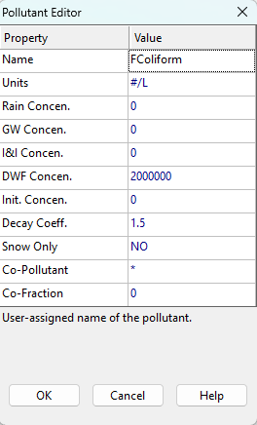
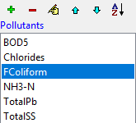
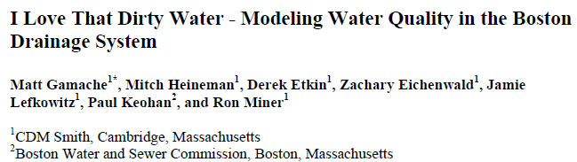
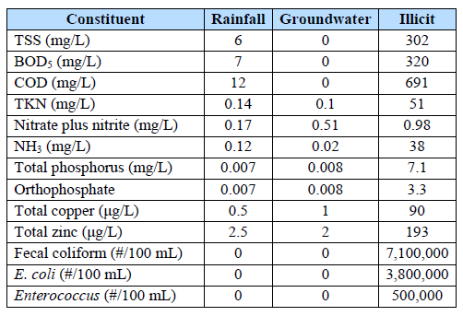
Pollutant Input Parameters
Pollutant name
Concentration units (i.e., milligrams/liter, micrograms/liter, or counts/liter for microorganisms)
(optional) Concentration by source (used for Wet Deposition)
Rainfall: Pollutant concentration in Subcatchment rainfall
Groundwater: Concentration in defined Aquifers
I&I: Concentration in rainfall-dependent infiltration/inflow
DWF: Concentration in dry weather flow (in sanitary sewers), can be overridden by editing the node’s Inflows property
Initial: Initial concentration throughout the conveyance system
See Table 2-6 in Vol. 3 Ref. Manual (& Table 7 from CDM Smith)

Slide 21
Pollutant Input Parameters (continued)
(optional) Decay coefficient: A first-order reaction coefficient (in units of 1/days) used to compute the rate at which the constituent decays due to reaction or other processes once it enters the conveyance portion of a SWMM model
Snow Only: Enter YES if pollutant buildup occurs only when there is snow cover (e.g., chlorides), the default value is NO
(optional) Co-pollutant designation:
Co-Pollutant: Name of another pollutant whose runoff concentration adds to the current pollutant’s runoff concentration
Co-Fraction: Fraction of the co-pollutant’s runoff concentration that contributes to the current pollutant’s runoff concentration (i.e., the concentration is linearly related by a constant fraction)

Slide 22
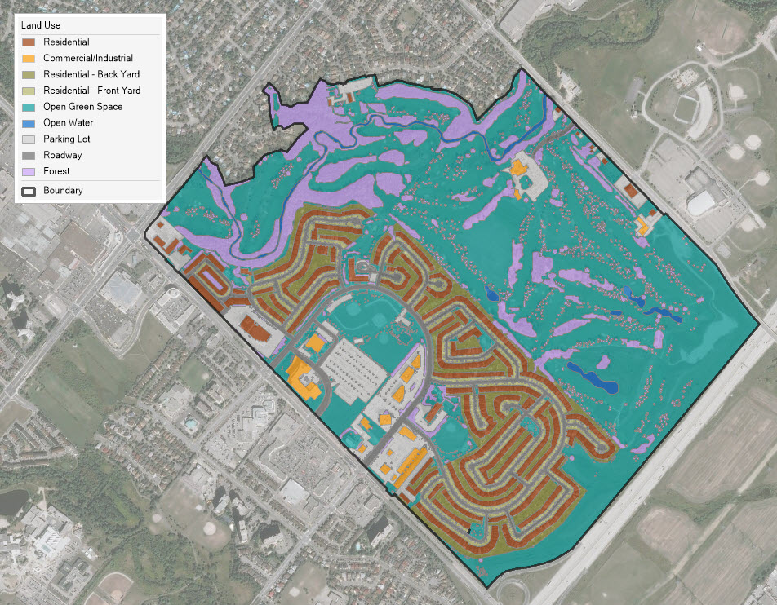
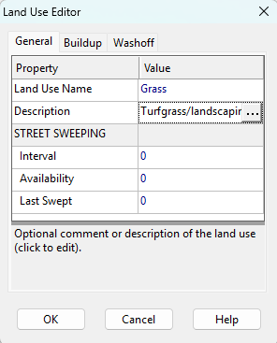
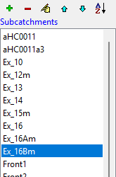
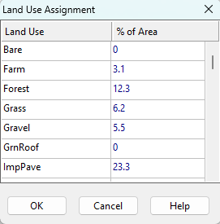
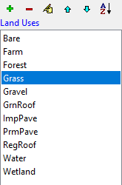
Pollutant Land Uses
Pollutants associated with runoff are generated by specific land uses assigned to subcatchments
Usually based on zoning type, but can use the same surface cover material categories that are generally used to create a Hydrology model
Note: check your land use percentages – SWMM5 doesn’t check if the total coverage is >100%

Slide 23
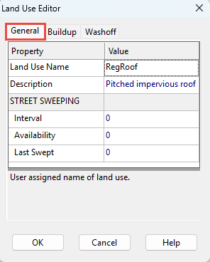
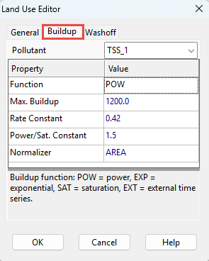
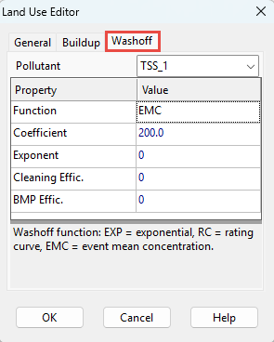
Pollutant Land Uses (continued)
Accounts for spatial variation within subcatchments, distinguishing pollutant source areas by…
Zoning (coarse spatial resolution)
Surface cover (high level of detail)
Affects water quality parameters for each pollutant:
Operations (street sweeping activities)
Pollutant buildup/washoff rates
BMP efficiency
Land use designations do not affect runoff quantity

Slide 24
Surface Buildup and Washoff
EWRI Congress 2025, EPA SWMM5 Workshop -- Water Quality Modeling

Slide 25
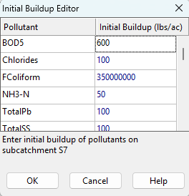
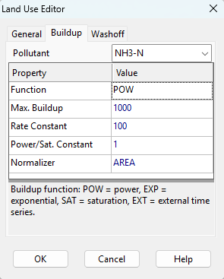
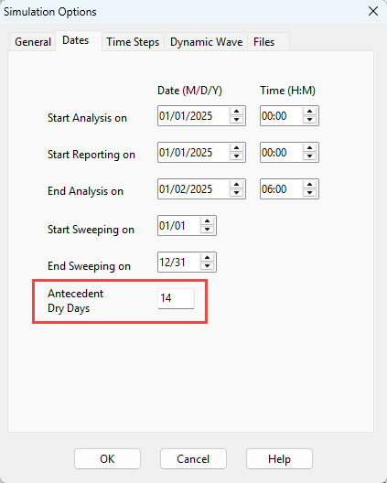
Dry Weather Buildup on Subcatchments
Buildup functions derived from empirical data for specific land uses
Static initial buildup:
Initial pollutant buildup (mass per area) over the entire subcatchment
Specified in the [LOADINGS] section of the input file
If dynamic buildup is not used, there is no further buildup/washoff once the initial load is depleted
Dynamic buildup:
Initial pollutant build-up based on pollutant function and number of antecedent dry days (prior to simulation start)
If static buildup is used, initial dynamic buildup is overruled
After simulation start, dynamic buildup occurs during dry periods (according to the selected pollutant function)

Slide 26
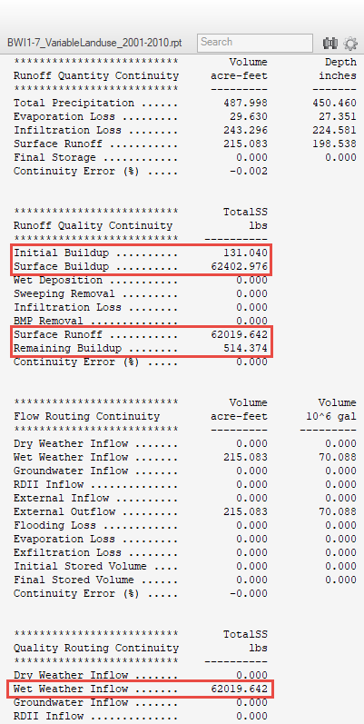
Tracking Buildup Loads
During wet weather, built-up pollutants are washed into the hydraulic network along with the surface runoff
Components of buildup loads are summarized (for all subcatchments) in the Runoff Quality Continuity table
Initial Buildup: Dry weather load prior to the simulation start
Surface Buildup: Dry weather load during periods of no rain
Surface Runoff: Portion of buildup load that enters the hydraulic network
Remaining Buildup: Portion of buildup load that stays behind
Surface Runoff is discharged into the hydraulic network (and included as the “Wet Weather Inflow” in the Quality Routing Continuity summary table)

Slide 27
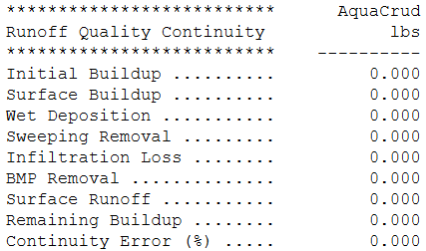
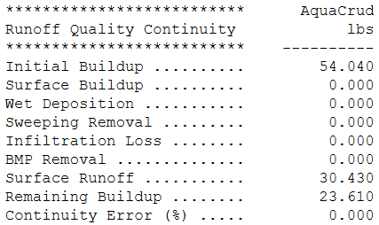
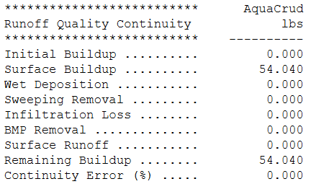
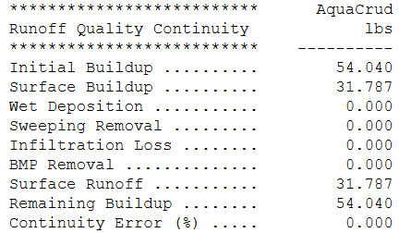
Buildup Load Examples
1-hour simulation with 1-hour rainfall duration
Initial Buildup is a function of the number of antecedent dry days
There is no Surface Buildup in both cases (there is no dry period)
12-hour simulation (1 hour of rainfall followed by 11 hours of no rain)
0 dry days before start
7 dry days before start
0 dry days before start
7 dry days before start

Slide 28
SWMM5 Pollutant Buildup
Dynamic Buildup Function | Equation
Power Function
Exponential Function
Saturation Function
External Time Series | Uses a time series to describe the rate of buildup
$B$= pollutant buildup
$C_{1}$= maximum buildup possible (mass per unit area or curb length)
$C_{2}$= buildup rate constant
$C_{3}$(POW) = buildup time exponent
$C_{3}$(SAT) = half-saturation constant (days to reach half of max. buildup)
$t$= time
$$B=Min(C_{1},C_{2}t^{C_{3}})$$
$$B=C_{1}(1−e^{−C_{2}t})$$
$$B=\frac{C_{1}t}{C_{2}+t}$$

Slide 29
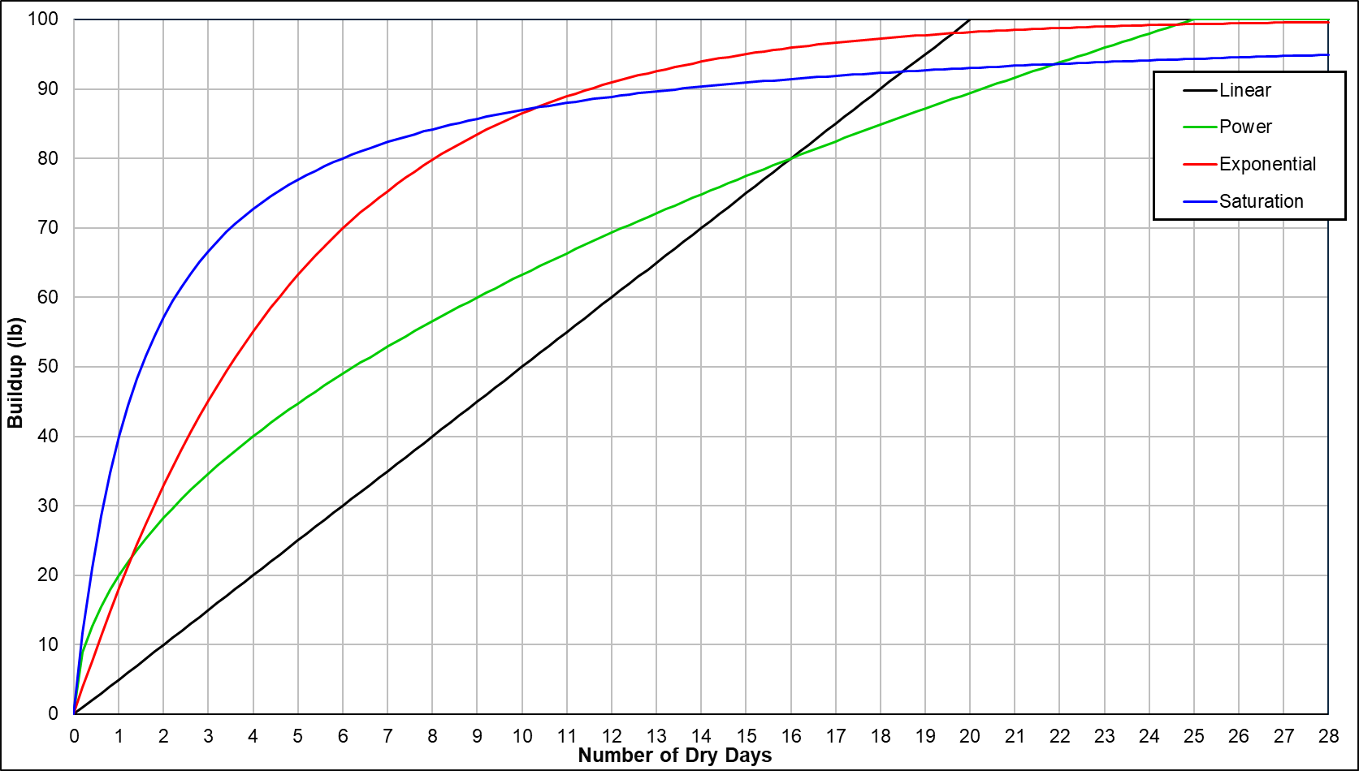
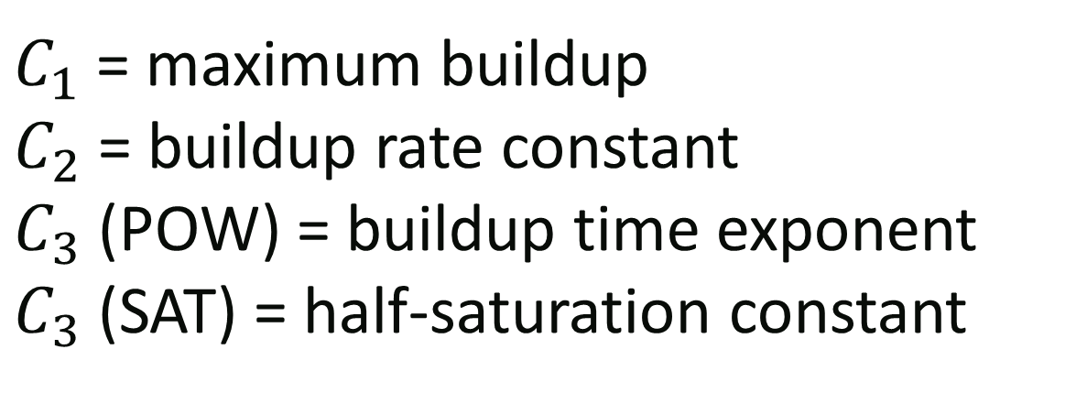
Comparison of Dynamic Buildup Functions
SWMM5 does not save buildup as a timeseries, but you can track the Initial Buildup for various antecedent dry day periods…

Slide 30
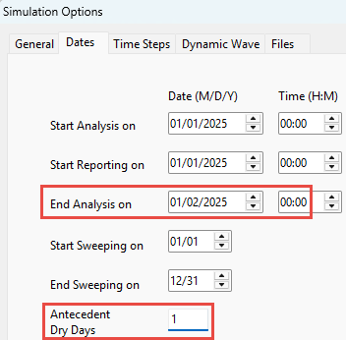
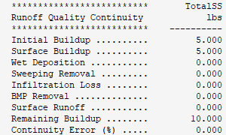
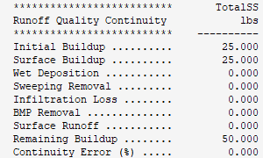
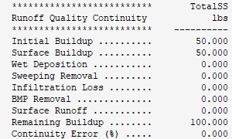


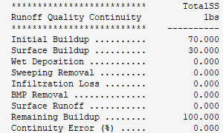

Another Buildup Load Example
Static initial buildup (100 lb max.) with dynamic buildup using a Linear function
Set number of dry days before start = days of simulation with no rainfall (so that the Initial Buildup and Surface Buildup totals are the same)
1 dry day before and
1 dry day after simulation start
5 dry days
10 dry days
11 dry days
14 dry days
99 dry days

Slide 31
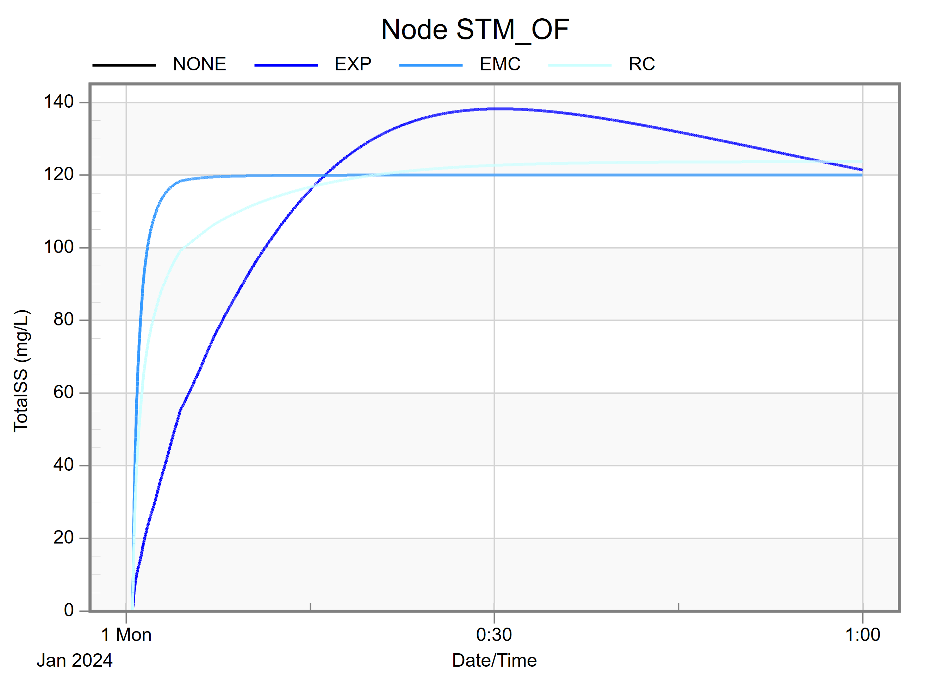
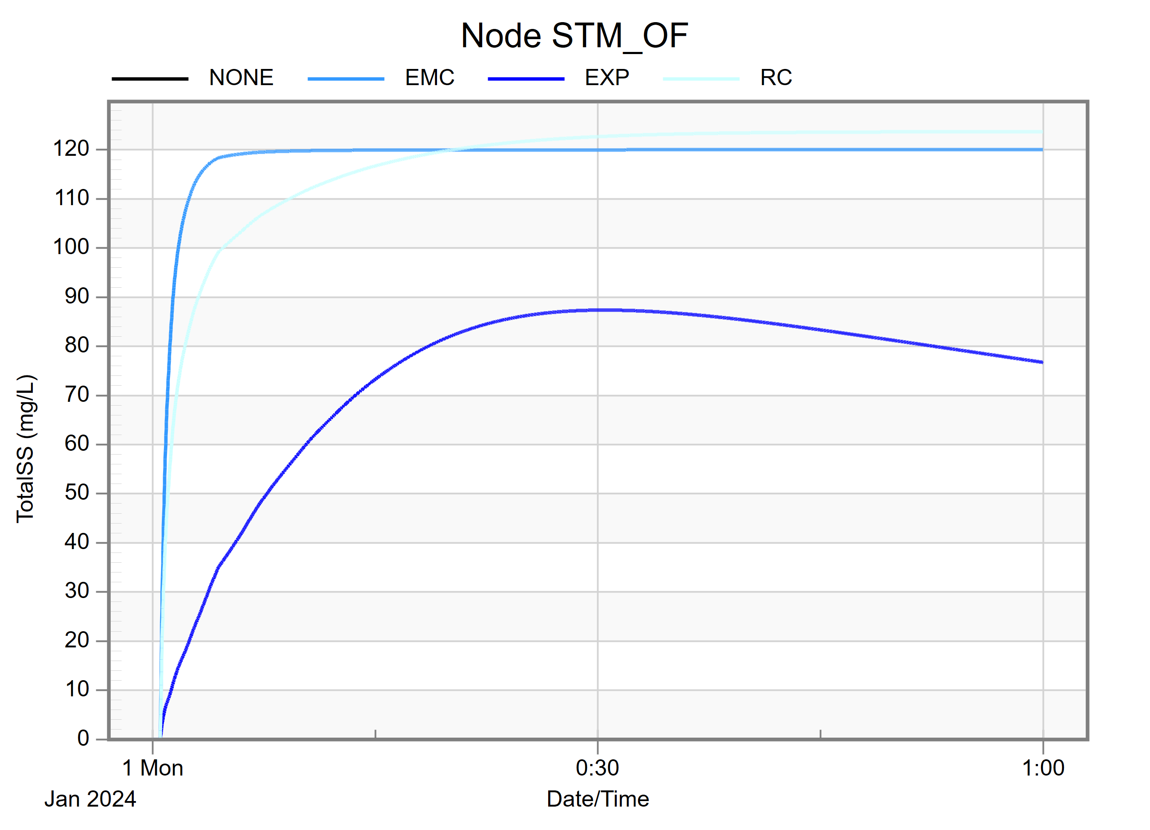
Important Note
SWMM5 Washoff Functions
NONE: No washoff of subcatchment buildup
EXP: Exponential washoff function
EMC: Event Mean Concentration washoff function
RC: Rating Curve washoff function
When using dynamic buildup functions with dynamic washoff functions…
The Surface Runoff load (i.e., pollutants that are washed off into the hydraulic network) is only affected by the Exponential washoff function
Initial Buildup loads will still be computed for the other washoff functions, indicating the maximum pollutant load that could be removed
Washoff Results
(Static Buildup)
Washoff Results (Static Buildup)
Washoff Results (EXP Buildup)
Washoff Results
(EXP Buildup)

Slide 32
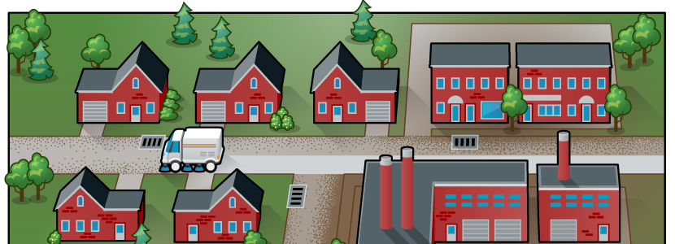
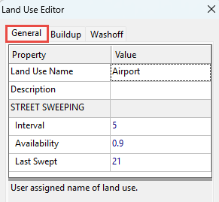
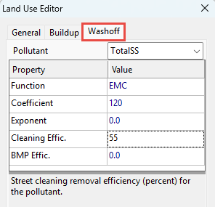


Street Sweeping Removal
Reduces the dynamic buildup of pollutants (before and after the start of simulation)
Parameters required for street sweeping include:
Interval: Days between sweeping
Availability: Fraction of buildup that is available for removed by sweeping
Last Swept: Days since the last sweeping at the start of the simulation
Cleaning Effic.: Street cleaning removal efficiency (percent) for the pollutant
Runoff Quality Continuity table includes the total Sweeping Removal load
Street sweeping operations dates (Simulation Options)

Slide 33


Example Linear Buildup and Street Sweeping

Slide 34

Guidance
Several helpful tables in Chapter 3 of the Vol. 3 Reference Manual
And local examples in practice…

Slide 35

Wet Weather Washoff from Subcatchments
Washoff functions are also derived from empirical data for specific land uses
Physically-based methods are preferable (e.g., based on erosion detachment and sediment transport), but simplistic functions are useful and you probably don’t have any calibration data anyway
SWMM5 Washoff Functions
NONE: No washoff of subcatchment buildup
EXP: Exponential washoff function
EMC: Event Mean Concentration washoff function
RC: Rating Curve washoff function

Slide 36
SWMM5 Pollutant Washoff
Washoff Function | Equation
Exponential Washoff
Rating Curve Washoff
Event Mean Concentration | Special case of rating curve method with C₂ = 1
$B$= pollutant buildup
$W$= pollutant washoff
$C_{1}$= washoff coefficient
$C_{2}$= washoff exponent
$q$= runoff rate (in/hr) over subcatchment
$Q$= runoff rate (cfs) over land use area
$$W=C_{1}q^{C_{2}}B$$
$$W=C_{1}Q^{C_{2}}$$

Slide 37

EMC Washoff
$$W=C_{1}Q$$
Most popular method, despite being the least accurate
EMC values are very commonly available (see Vol.3 Ref. Manual and https://bmpdatabase.org/national-stormwater-quality-database)
Washoff is only a function of the subcatchment runoff and EMC
Concentration [mg/L] is constant during the storm (i.e., it equals the EMC while there is subcatchment runoff AND buildup load available)
Loading rate [lb/s or mg/s] varies with the runoff rate
And remember that SWMM5 sometimes forces variables to zero
Subcatchment runoff = 0 when computed runoff in next timestep < 0.001 cfs
Conduit velocity = 0 when computed conduit depth in next timestep < 0.01 ft
etc.

Slide 38

RC Washoff
$$W=C_{1}Q^{C_{2}}$$
Empirically described, but physics also suggests the mass loading rate of particulate pollutants is proportional to flow rate raised to some power
Just like EMC washoff, RC washoff is not a function of Buildup load, but…
If washoff is supply-limited (i.e., Buildup load ≤ Washoff load), then washoff continues until the buildup amount is depleted
If unlimited supply for washoff (i.e., Buildup load ≥ Washoff load), then washoff continues until the runoff runs out
Parameter sensitivity (hold C₁ constant and vary C₂ exponent for one simple case):

Slide 39


EXP Washoff
$$W=C_{1}q^{C_{2}}B$$
Finally, a function that is dependent on buildup, originally based on the work of Sartor & Boyd (1972) and included in SWMM1 and all subsequent versions
That is, the washoff loading rate is proportional to the product of unit-area runoff raised to some power AND to the product of the remaining buildup load
Parameter sensitivity (vary C₁ with fixed C₂ exponent for one simple case):
C₁=0.3 and C₂=1.5
C₁=0.35 and C₂=1.5

Slide 40





Comparison of Washoff Functions
[WASHOFF]
;;Land Use Pollutant Func C1 C2 SweepRmvl BmpRmvl
Subcatch1 TotalSS NONE 99 99 0 0
Subcatch2 TotalSS EMC 120 9.9 0 0
Subcatch3 TotalSS RC 3500 1.1 0 0
Subcatch4 TotalSS EXP 0.35 1.5 0 0
Compare washoff function types
All use static initial buildup (100 lb max.)
Run for 1 hour of rainfall (no dry period after)
Input: “99” means parameter not used by SWMM5
Compare for various rainfall conditions
1 hour of rainfall followed by 8 hours of no rain
100-year/24-hour design storm event
Continuous simulation for a 10-year period
NONE
EMC
RC
EXP

Slide 41

Comparison of Washoff Functions (continued)
1hr vs 9hr simulation (runoff ends at 5am)
1 hr
9hr

Slide 42


Comparison of Washoff Functions (continued)
100-year/24-hour design storm event vs 10-year continuous simulation

Slide 43




Hydraulic Inputs for Water Quality
Other ways to add to (or bypass) surface washoff loads and concentrations
Included in Baseflow
Included in Dry Weather Flow (DWF)
As a Direct Inflow while there is runoff
As a Timeseries
Any combination of the above

Slide 44
Routing and Treatment
EWRI Congress 2025, EPA SWMM5 Workshop -- Water Quality Modeling

Slide 45
Advection, Dispersion, Reaction
Advection: transport of a substance driven by the bulk movement of water
Dispersion: spreading of a substance caused by velocity variations within the flow
Reaction: chemical, biological, or physical processes that alter the concentration of a substance over time
SWMM5: “mass reacted” is the pollutant load removed from the water column

Slide 46


1-D Advection Dispersion Equation
Used to represent solute transport in a moving fluid
Assumes uniform flow, constant coefficients, no sorption, etc.
advection term
dispersion term
reaction rate term
$$\frac{∂c}{∂t}=−\frac{∂\left(uc\right)}{∂x}+\frac{∂}{∂x}\left(D\frac{∂c}{∂x}\right)+r(c)$$
Where:
$c$ = constituent concentration [M/L³]
$u$ = longitudinal velocity [L/T]
$D$ = longitudinal dispersion coefficient [L²/T]
$x$ = longitudinal distance [L]
$t$ = time [T]
$r(c)$ = reaction rate [M/L³T]

Slide 47
SWMM5 Assumptions & Limitations
Routing is performed after the hydraulic computation at each routing step, with the assumption that it does not influence the hydraulic results
Routing within conduit links and storage nodes assumes behavior as a continuously-stirred tank reactor
In non-storage nodes, the quality of water exiting the node is simply the mixture concentration of all water entering the node
Concentration remains unchanged through links with no volume (pumps, orifices, weirs, outlets, and dummy conduits)
Plug flow reactor assumption might be more realistic, however differences will be small if the travel/residence time is on the same order as the routing time step
Order of calculation
Hydraulic routing
Node concentration
Node treatment
Link concentration

Slide 48





Instantaneous Complete Mixing at Junctions
Non-storage nodes have no volume
$$C_{Nj}=\frac{\sum_{i→j}{C_{L2i}q_{2i}+W_{j}}}{\sum_{i→j}{q_{2i}}+Q_{j}}$$
Where:
$C_{Nj}$ = concentration at node $j$
$C_{L2i}$ = concentration at the end of link $i$
$q_{2i}$= flow rate at the end of link $i$
$W_{j}$ = mass flow rate of the external source of constituent
$Q_{j}$ = flow rate of the external source
Link $i=1$
$$j$$
Link $i=2$
External source $W_{j}$

Slide 49



Complete Mixing in Storage Junctions
Storage units have volume property
$$\frac{d(V_{Nj}C_{Nj})}{dt}=\sum_{i→j}{C_{L2i}q_{2i}−\sum_{j→k}{C_{Nj}q_{1k}}}+W_{j} − V_{Nj}r(C_{Nj})$$
Where:
$V_{Nj}$ = volume of water storage at node $j$
$C_{Nj}$ = concentration at node $j$
$C_{L2i}$ = concentration at the end of link $i$
$q_{2i}$= flow rate at the end of link $i$
$q_{1k}$= flow rate at the start of link $k$
$W_{j}$ = mass flow rate of the external source of constituent
$r$ = reaction rate in the storage
Link $i=1$
Link $k=1$
$$j$$
j
Link $i=2$
External source $W_{j}$

Slide 50


Quality Routing Assumes Complete Mixing
Tanks in series model
$$\frac{d(Vc)}{dt}=C_{in}Q_{in}−cQ_{out}−VK_{1}c$$
Where:
$V$ = reactor volume
$C_{in}$ = influent pollutant concentration
$c$ = effluent and reactor pollutant concentration
$Q_{in}$ = volumetric inflow rate
$Q_{out}$ = volumetric outflow rate
$t$ = time
$K_{1}$ = decay coefficient

Slide 51



SWMM 5 Solution
$$c\left(t+∆t\right)= \frac{c\left(t\right)V\left(t\right)e^{{−K}_{1}∆t}+C_{in}Q_{in}∆t}{V\left(t\right)+Q_{in}∆t}$$
Where:
$c\left(t+∆t\right)$ = reactor concentration at end of routing step $∆t$
$c\left(t\right)$ = reactor concentration at start of routing step
$V\left(t\right)$ = reactor volume at start of the routing step
$C_{in}$ = node inflow concentration
$Q_{in}$ = net inflow rate
$$C_{in}Q_{in}$$
$$c\left(t\right)V\left(t\right)$$

Slide 52


Routing for Links without Volume
Node concentrations are calculated first during the routing process
Links with no volume property include:
Pumps
Orifices
Weirs
Outlets
Dummy conduits
In these cases, link concentration is equal to that of the upstream node
$$c$$
$$c$$

Slide 53


Treatment Expressions
Treatment expressions can be applied at any node, either concentration-based or removal-based, and depending on a range of hydraulic variables
$$c\left(t+∆t\right)=c(C, R, H)$$
$$c\left(t+∆t\right)=(1−r\left(C,R,H\right))C_{in}\left(t+∆t\right)$$
Where:
𝑐 = nodal pollutant concentration after treatment is applied
$C_{in}$ = pollutant concentration in the node’s inflow stream
𝑐(…) = concentration-based treatment function
𝑟(…) = removal-based treatment function
𝑪 = vector of nodal pollutant concentrations before treatment is applied
𝑹 = vector of fractional removals resulting from treatment
𝑯 = vector of hydraulic variables at the current time step

Slide 54
Water Quality Treatment
After computing the water quality routing of pollutants, treatment operations are calculated for each pollutant at each node during each time step
Treatment expressions can be applied at any node, either as a concentration remaining after treatment (C = value or expression) or as a fractional removal (R = value or expression)
With non-storage nodes (i.e., junctions and outfalls), treatment results are dependent on the pollutant concentration and flow rate
For storage nodes, treatment results are also dependent on the depth, nodal surface area, routing time step, and hydraulic residence time within the node (or some combination, such as loading rate FLOW / AREA)

Slide 55
Treatment Expressions
A treatment expression can use
Variables
Functions
Numbers
Standard operators +,-,*,/,^
Pollutant names
Any level of nested parentheses
Names of variables and functions are case-insensitive

Slide 56


Simple Treatment Expressions
Simple EMC/Constant removal (e.g., inflow = 100 mg/L and desired outflow = 15 mg/L): C = 15 or R = 0.85 (see examples below)
Correlated removal, where pollutant treatment is proportional to the removal of another pollutant (e.g., if 50% of TSS1 removal): R = 0.5 * R_TSS1

Slide 57




Example – No Treatment vs Fixed Removal
No treatment (C_{in} = C_{out})
C_{In} = 1000 mg/L
C_{Out} = 1000 mg/L
C_{In} = 1000 mg/L
C_{Out} = C_{In} × (1-R) = 100 mg/L

Slide 58
Detailed Treatment Expressions
Represent removal based on influent concentration using STEP(expression) function:
If expression is positive, then value = 1; or
If expression is negative or 0, then value = 0
Example expression 1 : R = (1-STEP(TSS-50))*0.50 + STEP(TSS-50)*0.90
If inflow concentration > 50 mg/L then 90% TSS removal
If inflow concentration < 50 mg/L then 50% TSS removal
Other removal mechanisms are available
k-C* model (1st order)
N^{th} order reaction kinetics
Particulate settling by gravity

Slide 59



Example – Step Function Removal
C_{In} = 1000 mg/L
C_{Out} = C_{In} × (1-R) = 100 mg/L
C_{In} = 10 mg/L
C_{Out} = C_{In} × (1-R) = 5 mg/L
90% removal
50% removal

Slide 60


SWMM Sediment Modeling
Settling Ponds – Gravity Settling
To represent the deposition of particulates in the pond:
Develop treatment expression for each suspended solids mass fraction
Defines rate of settling as function of time and depth of water in the pond

Slide 61


Pond Design – Water Quality Treatment Volume
Storage volume requirements are often quantified as a function of contributing area imperviousness
Technical basis: presumed TSS removal on an average annual basis (e.g., Ontario guidelines)
City of Calgary Stormwater Management and Design Manual (2011)

Slide 62

Water Quality – Particulate Settling Parameters
To represent the deposition of particulates in the pond…
Develop treatment expression for each TSS mass fraction
Defines rate of settling as function of time and depth of water in the pond
TSS mass that settles out is removed from water column
Note: SWMM does not reduce available storage volume in the pond (generally okay if less than 1% of permanent pool volume)

Slide 63
Particulate Settling Results
************************** TSS_1 TSS_2 TSS_3 TSS_4 TSS_5 TSS_6
Quality Routing Continuity kg kg kg kg kg kg
************************** ---------- ---------- ---------- ---------- ---------- ----------
Dry Weather Inflow ....... 0.000 0.000 0.000 0.000 0.000 0.000
Wet Weather Inflow ....... 725.439 697.458 697.458 725.439 725.439 725.439
Groundwater Inflow ....... 0.000 0.000 0.000 0.000 0.000 0.000
RDII Inflow .............. 0.000 0.000 0.000 0.000 0.000 0.000
External Inflow .......... 0.000 0.000 0.000 0.000 0.000 0.000
External Outflow ......... 571.452 500.037 476.743 436.307 406.438 377.646
Flooding Loss ............ 0.000 0.000 0.000 0.000 0.000 0.000
Exfiltration Loss ........ 0.000 0.000 0.000 0.000 0.000 0.000
Mass Reacted ............. 147.612 191.172 214.706 283.674 313.563 342.228
Initial Stored Mass ...... 0.000 0.000 0.000 0.000 0.000 0.000
Final Stored Mass ........ 1.514 1.504 1.503 1.502 1.499 1.495
Continuity Error (%) ..... 0.670 0.680 0.646 0.545 0.543 0.561
Mass reacted (increasing load is removed as particle size increases)
Mass reacted includes both treatment and reactions. It may be negative if the reaction results in pollutant growth (e.g., bacteria).
***********************
Outfall Loading Summary
***********************
-----------------------------------------------------------------------------------------------------------------------------------------------
Flow Avg. Max. Total Total Total Total Total Total Total
Freq. Flow Flow Volume TSS_1 TSS_2 TSS_3 TSS_4 TSS_5 TSS_6
Outfall Node Pcnt. CMS CMS 10^6 ltr kg kg kg kg kg kg
-----------------------------------------------------------------------------------------------------------------------------------------------
Hopewell_OF1 9.91 0.000 0.013 0.478 52.373 52.373 52.373 52.373 52.373 52.373
Hopewell_OF2 100.00 0.048 0.100 892.070 53.729 53.450 53.125 50.697 42.904 21.962
Hopewell_OF3 6.75 0.000 0.012 0.220 22.958 22.958 22.958 22.958 22.958 22.958
Hopewell_OF4 100.00 0.050 0.120 929.462 134.044 134.044 134.044 134.044 134.044 134.044
Randall_OF1 27.57 0.000 0.010 1.947 102.389 60.190 49.869 39.585 37.435 36.996
Wetland_OF1 13.10 0.000 0.006 0.629 57.845 57.845 57.845 57.845 57.845 57.845
Hwy7_OF1 6.05 0.001 0.042 0.981 116.299 89.464 76.832 47.155 27.247 19.843
Hwy7_OF2 1.86 0.000 0.014 0.134 17.729 15.744 15.744 17.729 17.729 17.729
-----------------------------------------------------------------------------------------------------------------------------------------------
System 33.16 0.100 0.281 1825.920 557.366 486.069 462.790 422.386 392.536 363.750
Outfall load (increasing load is transported through the system as particle size decreases)

Slide 64

Particulate Settling Results
Smallest 20% mass fraction
Middlest 20% mass fraction
Largest 20% mass fraction

Slide 65
TSS Loading Summary
Sediment accumulation rate of 1.3 m³/ha/yr (April thru October)
Snowmelt and hydrologic conditions during winter months not modeled
Winter road operations introduces additional TSS loading
Estimated annual sediment accumulation rate of 2.6 m³/ha/yr
10-yr sediment volume = 940 m³ (available decant volume = 1,230 m³)

Slide 66



Example Project Details…
www.chijournal.org/C378
Under construction January 2013

Slide 67
Thank you for your attention… any questions?
EWRI Congress 2025, EPA SWMM5 Workshop -- LID Modeling
Mike Gregory, P.Eng., PE mike@chiwater.com

